Slide 1

HOSPITAL PERFOMANCE AND FINANCIAL METRICS
OLIVE GENERAL HOSPITAL
SANA AMBREEN

Slide 2
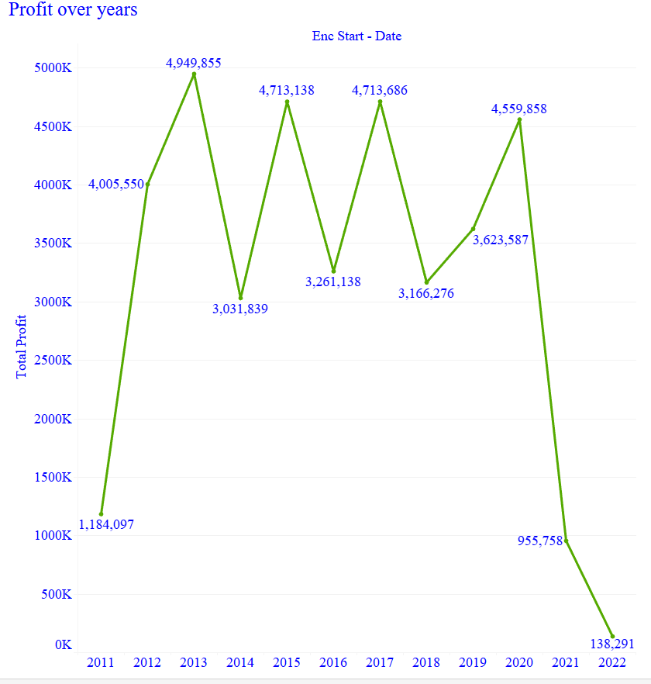
The Olive General Hospital is incurring huge losses in 2022 impacting hospital revenue and patient costs; Hence Hospital Management requests the community donors significant contribution to save hospital from crisis.

Slide 3
The primary focus is to maintain the hospital’s financial stability and continue providing quality care to patients.

Slide 4
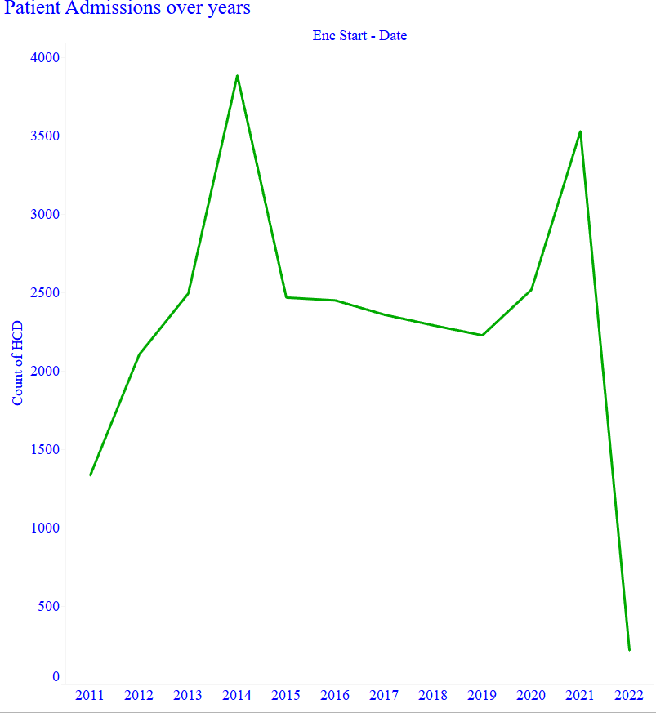
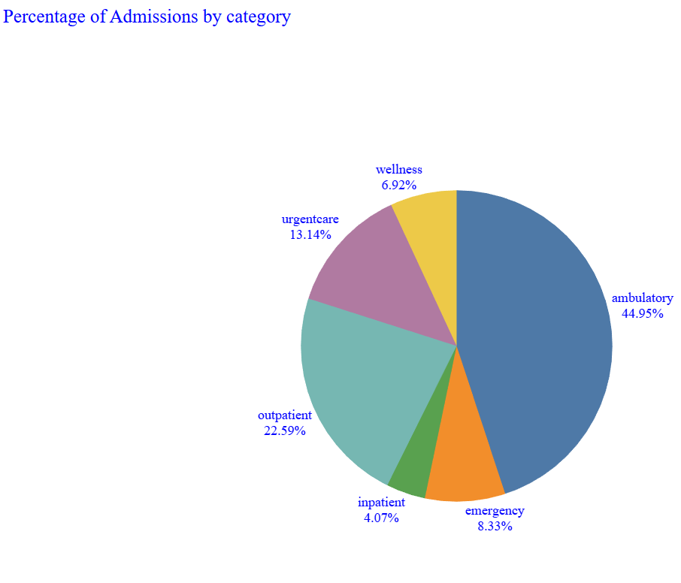
In 2022, there was a huge decline in patient admissions making it a cause for concern for the hospital
The Outpatient was the most affected category with a decline of about 50% from previous year

Slide 5
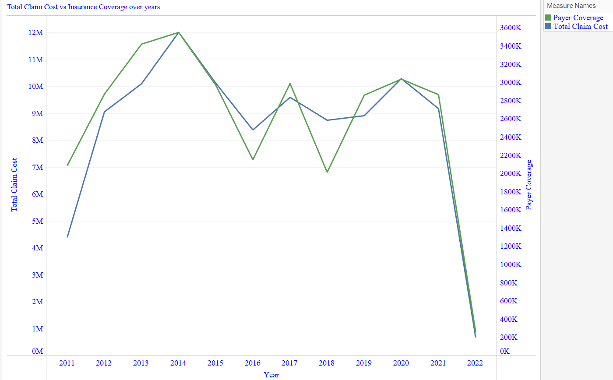
There was a huge drop in insurance coverage in 2022 impacting patients and hospitals
This could be the potential reason for decline in patient admissions

Slide 6
“The Healthcare cost shift”– Who pays the Price?

Slide 7
Hospital was affected with cash flow issues impacting their ability to operate efficiently.
Out of pocket costs increased leading to delayed treatments and financial hardships for many patients.

Slide 8
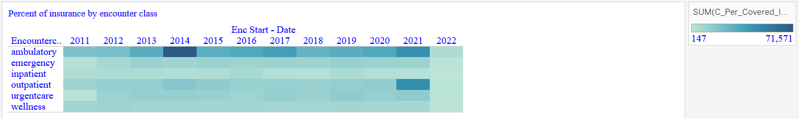
The outpatient category was the most affected because of reduction in insurance coverage.

Slide 9
Did the Insurance companies change policies unfairly at the cost of hospitals and patients?

Slide 10
Two opposing Forces
VICTIMS:
HOSPITAL
PATIENTS
DECISION MAKERS:
Insurance companies

Slide 11
ASK : Bridging the healthcare cost gap
Adjustment of coverage policies by insurance companies to avoid hospital and patient burden.
Addressing any loop holes that led to reduction in coverage.
Strengthen preventative care initiatives.
Increase funding by community donors to help bridge the financial gap.

Slide 12
Benefits:
If meaningful decisions are made on time, the hospital will become financially stable without compromising on the quality of patient care.
Risks:
The hospital will have to shutdown its operations due to financial instability.
Patients will loose access to nearby facility for emergency and urgent care.

Slide 13
